Slide 1
Semi-finished materials
Finger-jointed panels
Scantlings for windows and doors
Semi-finished door elements
Worktops

Slide 2
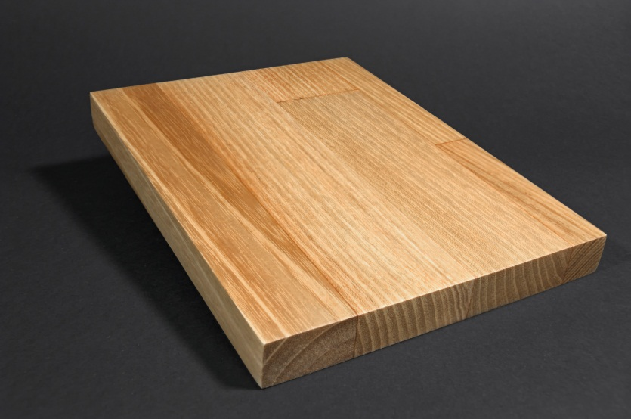
Finger-jointed panels
Acacia
Quality: AB
Thickness: 14-200mm
Width: 35-1300mm
Width of lamella: 20mm-40mm
Length: 6m
Humidity: 10% ±1.5%.
Glue: Kleibert D3, D4
May vary according customer wishes.

Slide 3
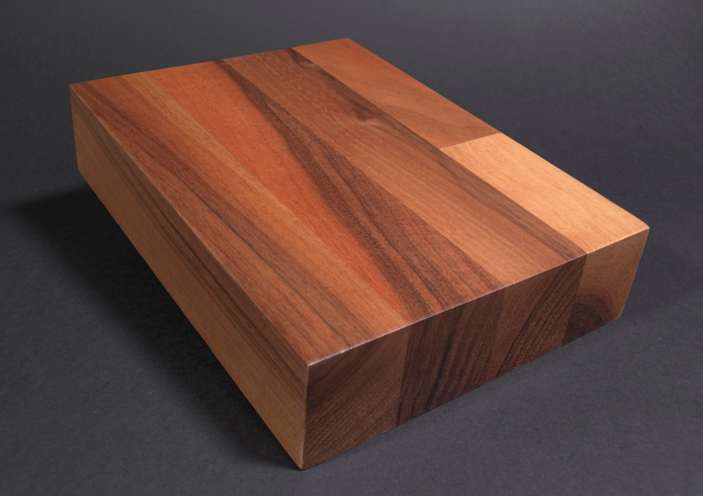
Finger-jointed panels
Walnut
Quality: Rustic
Thickness: 14-200mm
Width: 35-1300mm
Width of lamella: 20mm-40mm
Length: 6m
Humidity: 10% ±1.5%.
Glue: Kleibert D3, D4
May vary according customer wishes.

Slide 4
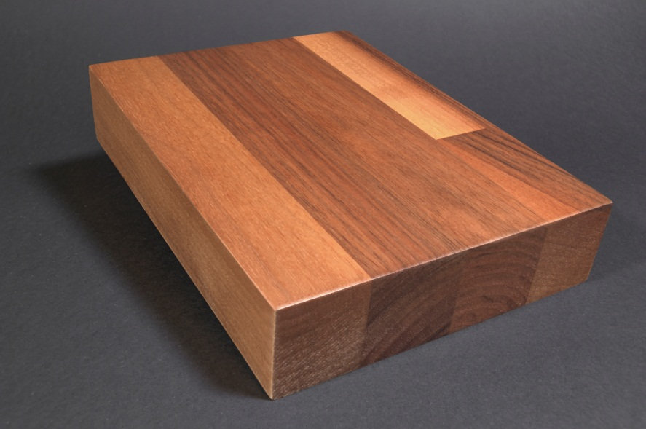
Finger-jointed panels
Walnut
Quality: Rustic
Thickness: 14-200mm
Width: 35-1300mm
Width of lamella: 20mm-40mm
Length: 6m
Humidity: 10% ±1.5%.
Glue: Kleibert D3, D4
May vary according customer wishes.

Slide 5
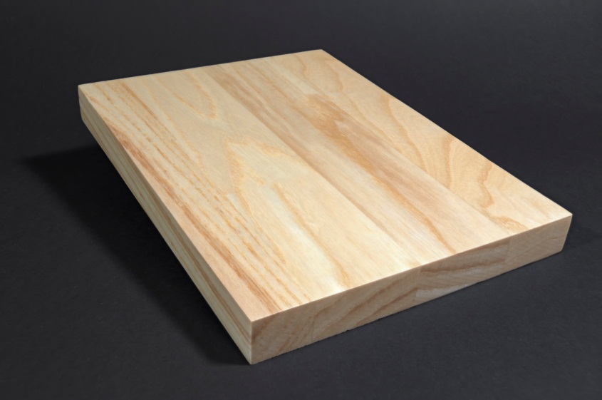
Finger-jointed panels
Ash
Quality: AB
Thickness: 14-200mm
Width: 35-1300mm
Width of lamella: 20mm-40mm
Length: 6m
Humidity: 10% ±1.5%.
Glue: Kleibert D3, D4
May vary according customer wishes.

Slide 6
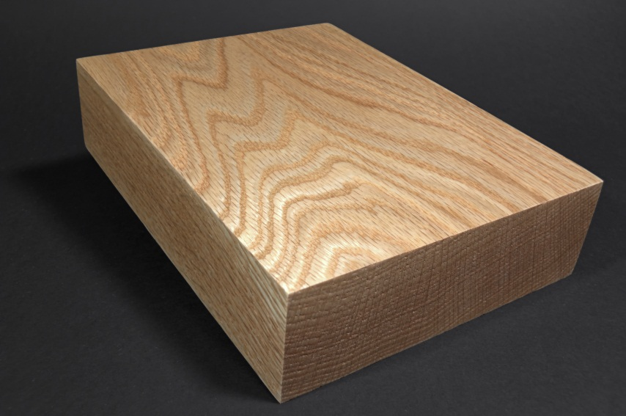
Finger-jointed panels
Oak
Quality: AB
Thickness: 14-200mm
Width: 35-1300mm
Width of lamella: 20mm-40mm
Length: 6m
Humidity: 10% ±1.5%.
Glue: Kleibert D3, D4
May vary according customer wishes.

Slide 7
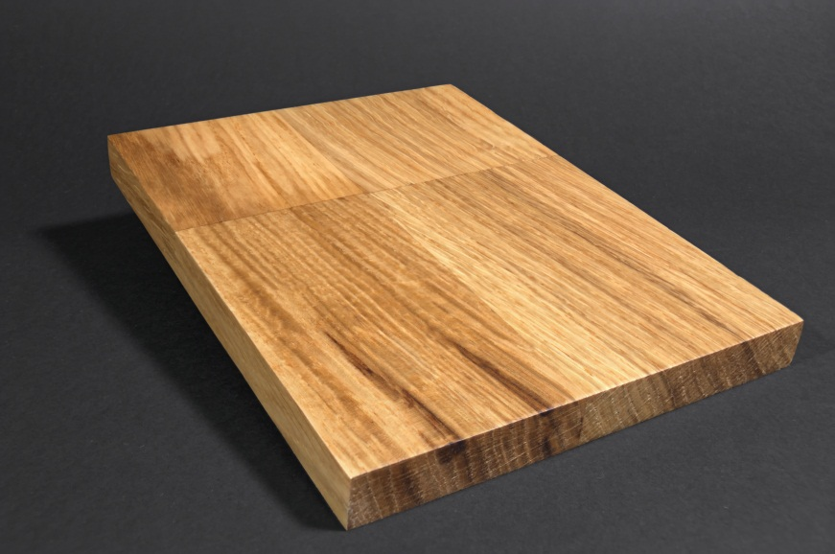
Finger-jointed panels
Oak
Quality: BB
Thickness: 14-200mm
Width: 35-1300mm
Width of lamella: 20mm-40mm
Length: 6m
Humidity: 10% ±1.5%.
Glue: Kleibert D3, D4
May vary according customer wishes.

Slide 8
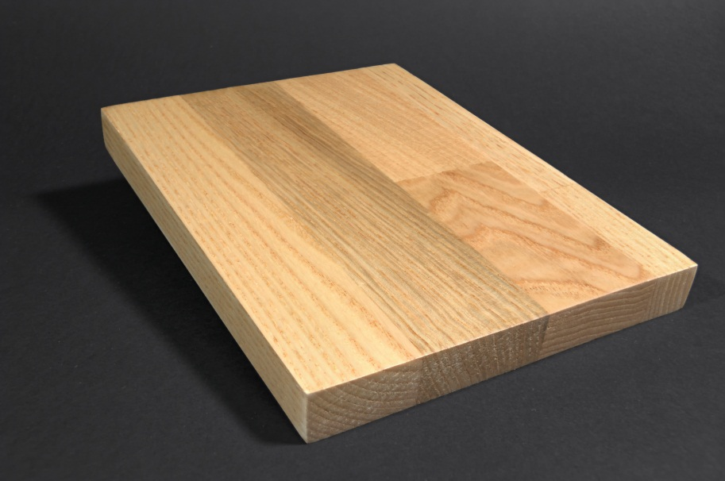
Finger-jointed panels
Chestnut
Quality: AB
Thickness: 14-200mm
Width: 35-1300mm
Width of lamella: 20mm-40mm
Length: 6m
Humidity: 10% ±1.5%.
Glue: Kleibert D3, D4
May vary according customer wishes.

Slide 9
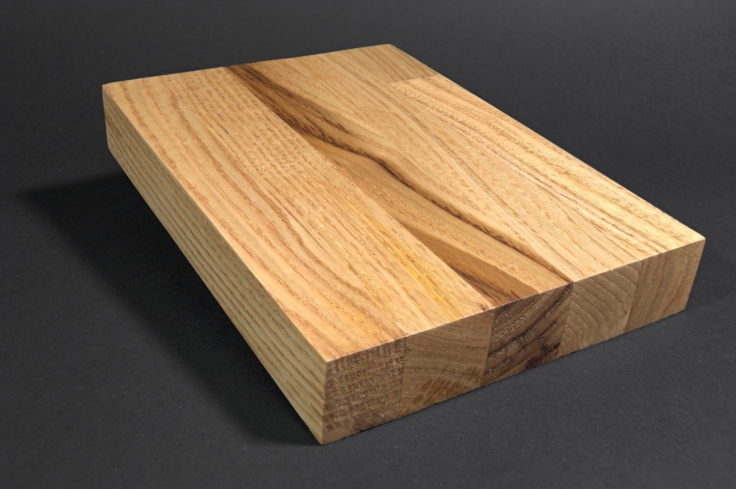
Finger-jointed panels
Chestnut
Quality: BB
Thickness: 14-200mm
Width: 35-1300mm
Width of lamella: 20mm-40mm
Length: 6m
Humidity: 10% ±1.5%.
Glue: Kleibert D3, D4
May vary according customer wishes.

Slide 10
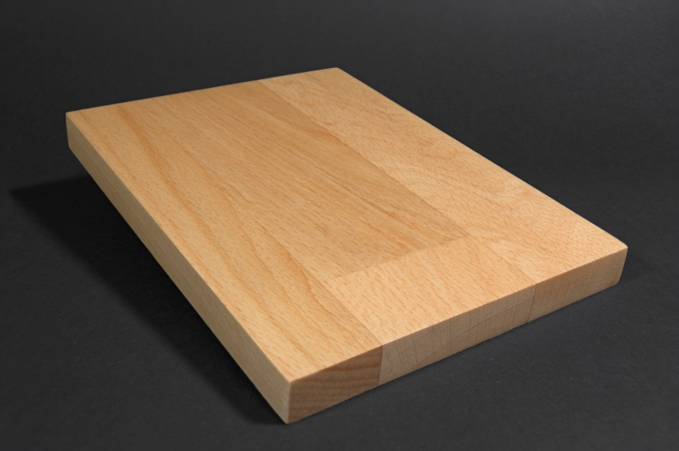
Finger-jointed panels
Beech
Quality: AB
Thickness: 14-200mm
Width: 35-1300mm
Width of lamella: 20mm-40mm
Length: 6m
Humidity: 10% ±1.5%.
Glue: Kleibert D3, D4
May vary according customer wishes.

Slide 11
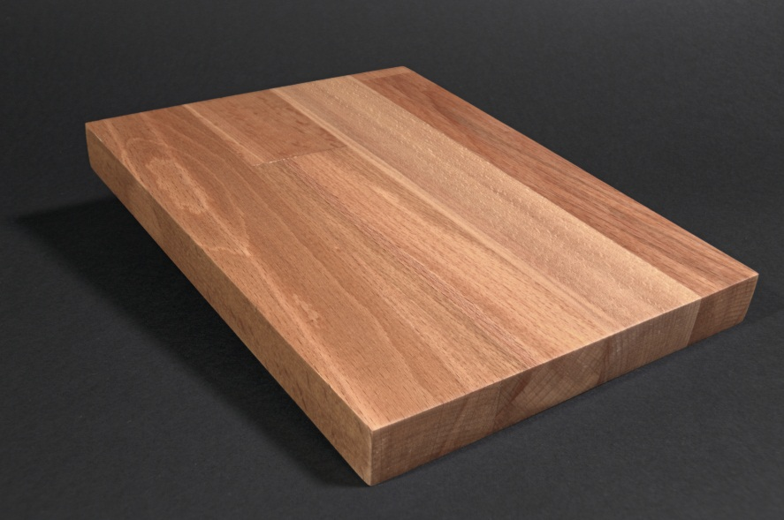
Finger-jointed panels
Beech
Quality: BB
Thickness: 14-200mm
Width: 35-1300mm
Width of lamella: 20mm-40mm
Length: 6m
Humidity: 10% ±1.5%.
Glue: Kleibert D3, D4
May vary according customer wishes.

Slide 12
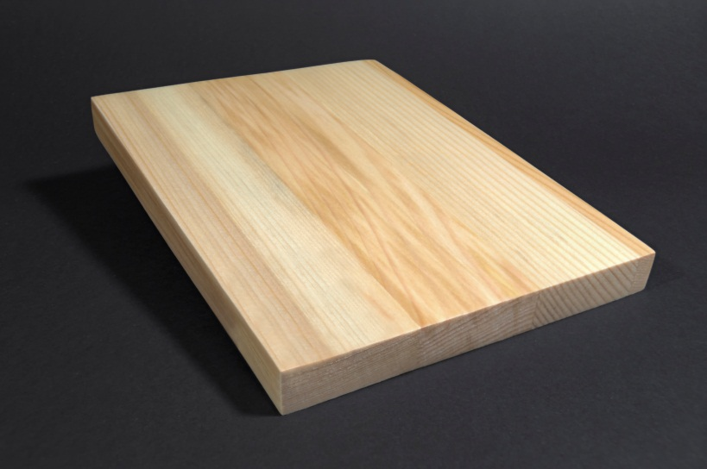
Finger-jointed panels
Coniferous
Quality: AB
Thickness: 14-200mm
Width: 35-1300mm
Width of lamella: 20mm-40mm
Length: 6m
Humidity: 10% ±1.5%.
Glue: Kleibert D3, D4
May vary according customer wishes.

Slide 13
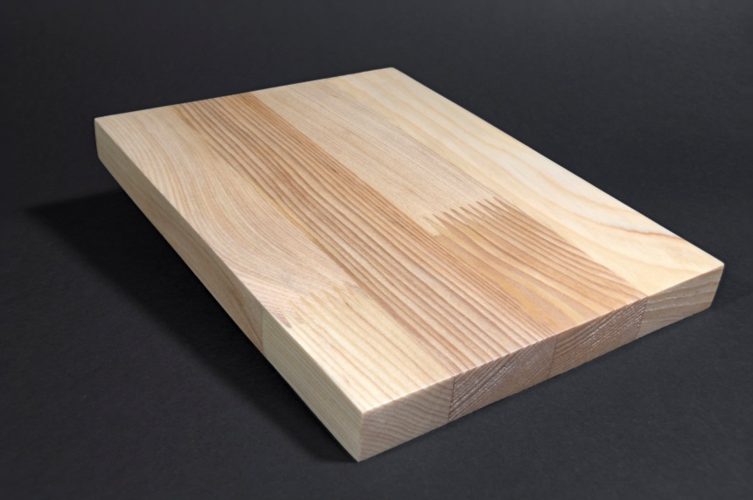
Finger-jointed panels
Coniferous
Quality: BB
Thickness: 14-200mm
Width: 35-1300mm
Width of lamella: 20mm-40mm
Length: 6m
Humidity: 10% ±1.5%.
Glue: Kleibert D3, D4
May vary according customer wishes.

Slide 14
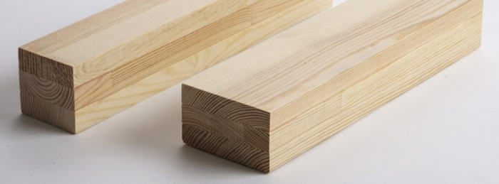
Scantlings for windows and doors
Sizes:
mm 48x95 - 120
mm 63x75 - 86 - 95 - 120
mm 66x75 - 86 - 95 - 120
mm 72x75 - 86 - 95 - 120
Specification: DKD
Gluing: UNI EN 204 D4
Humidity: 10 - 12%
On request it is possible to offer different size for minimum quantity ordered.

Slide 15
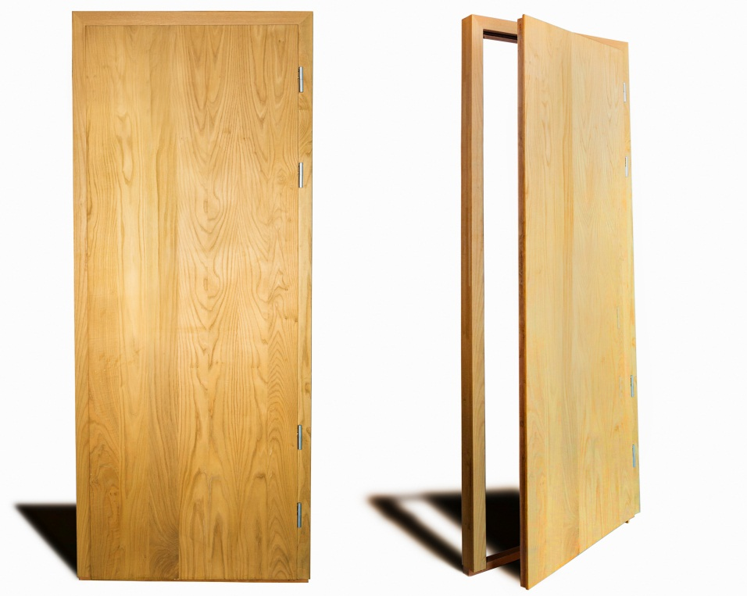
Semi-finished Door Elements
Door size (with frame) - 2200 mm, X900 mm
Board size - 2100 mm, X800 mm, X45 mm
Frame size - 70 mm, X900 mm, X2200 mm - 2 pcs, 70 mm, X90 mm, X900 mm - pcs
Lamellar width in the board: form 120 mm up to 160 mm.
The size and wood type varies according customer wishes.
We produce semi-finished elements for doors. This elements meet Euro Standards for doors. The final customer can use them for producing doors according to their own design

Slide 16
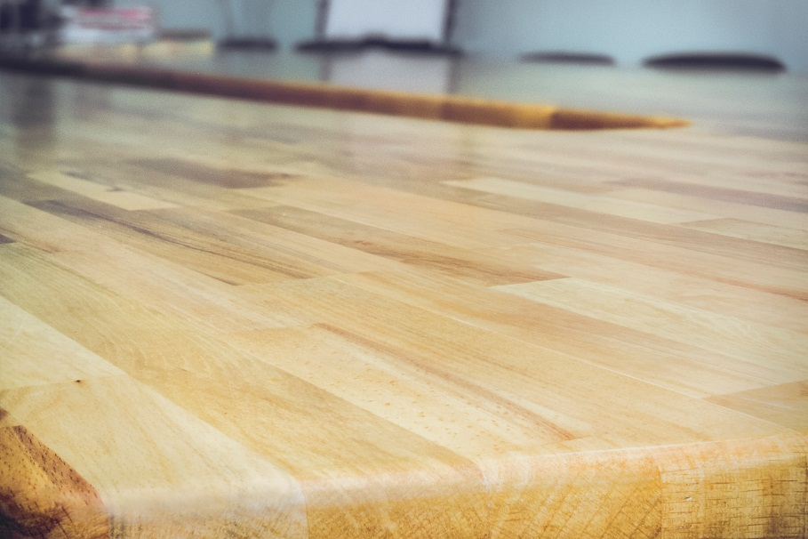
Worktops
We offer prime quality Acacia, Walnut, Chestnut, Coniferous, Beech, Ash, Oak solid wood worktops.
Sizes depend on customer request.

